Slide 2
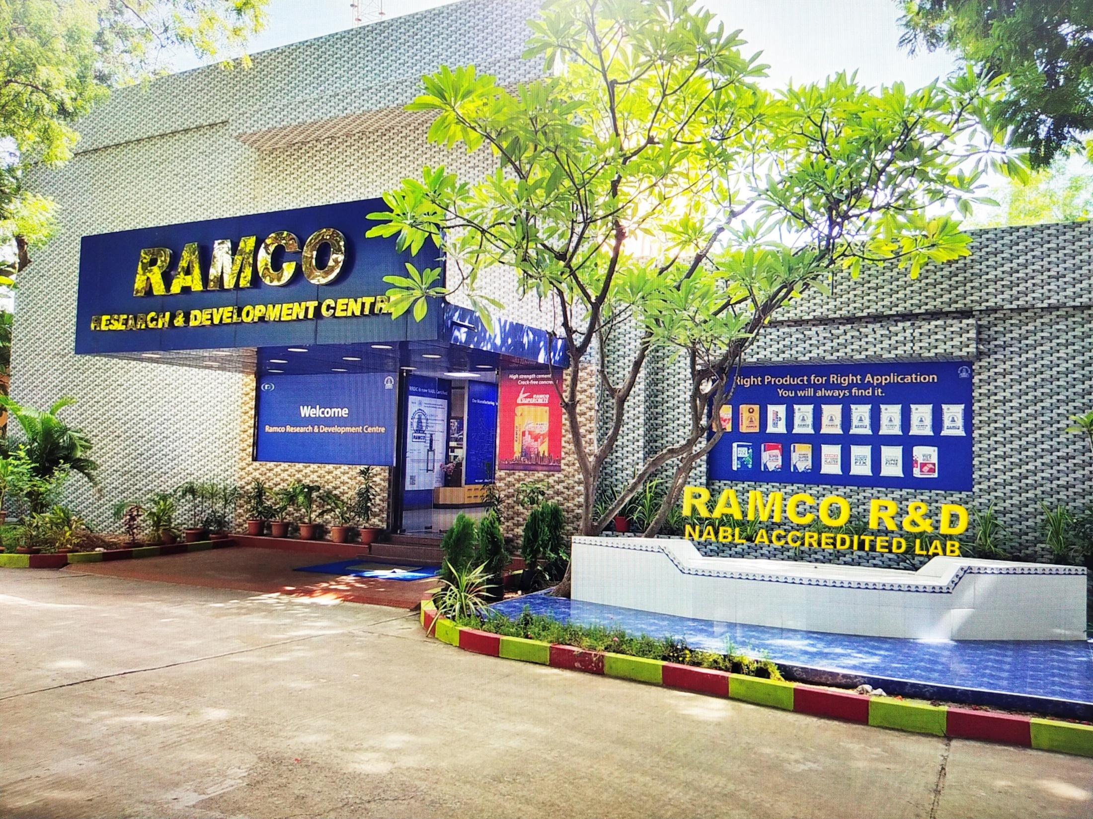

Slide 3
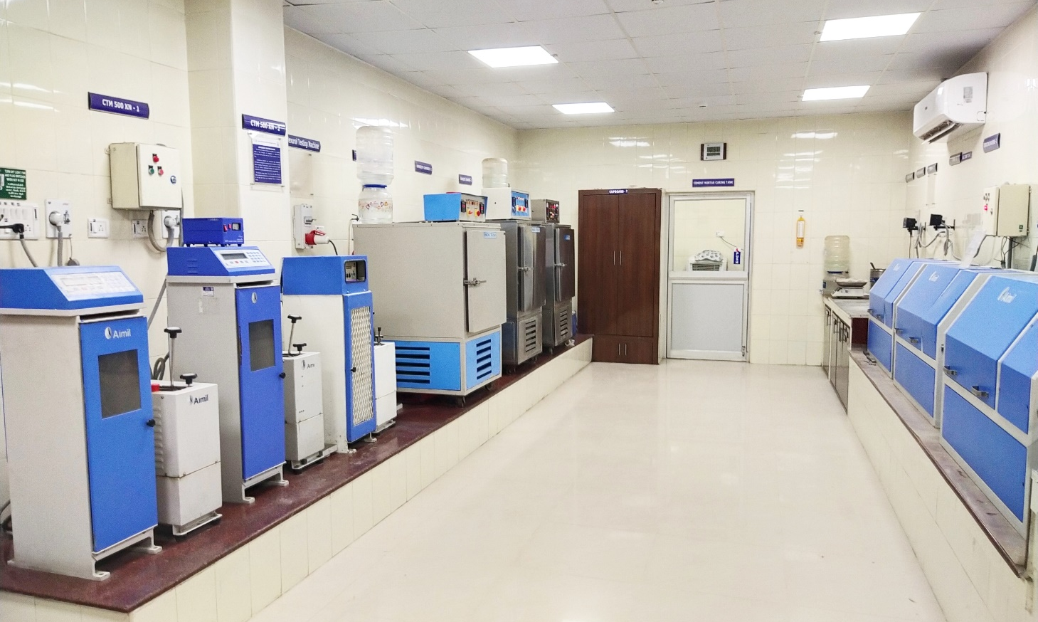
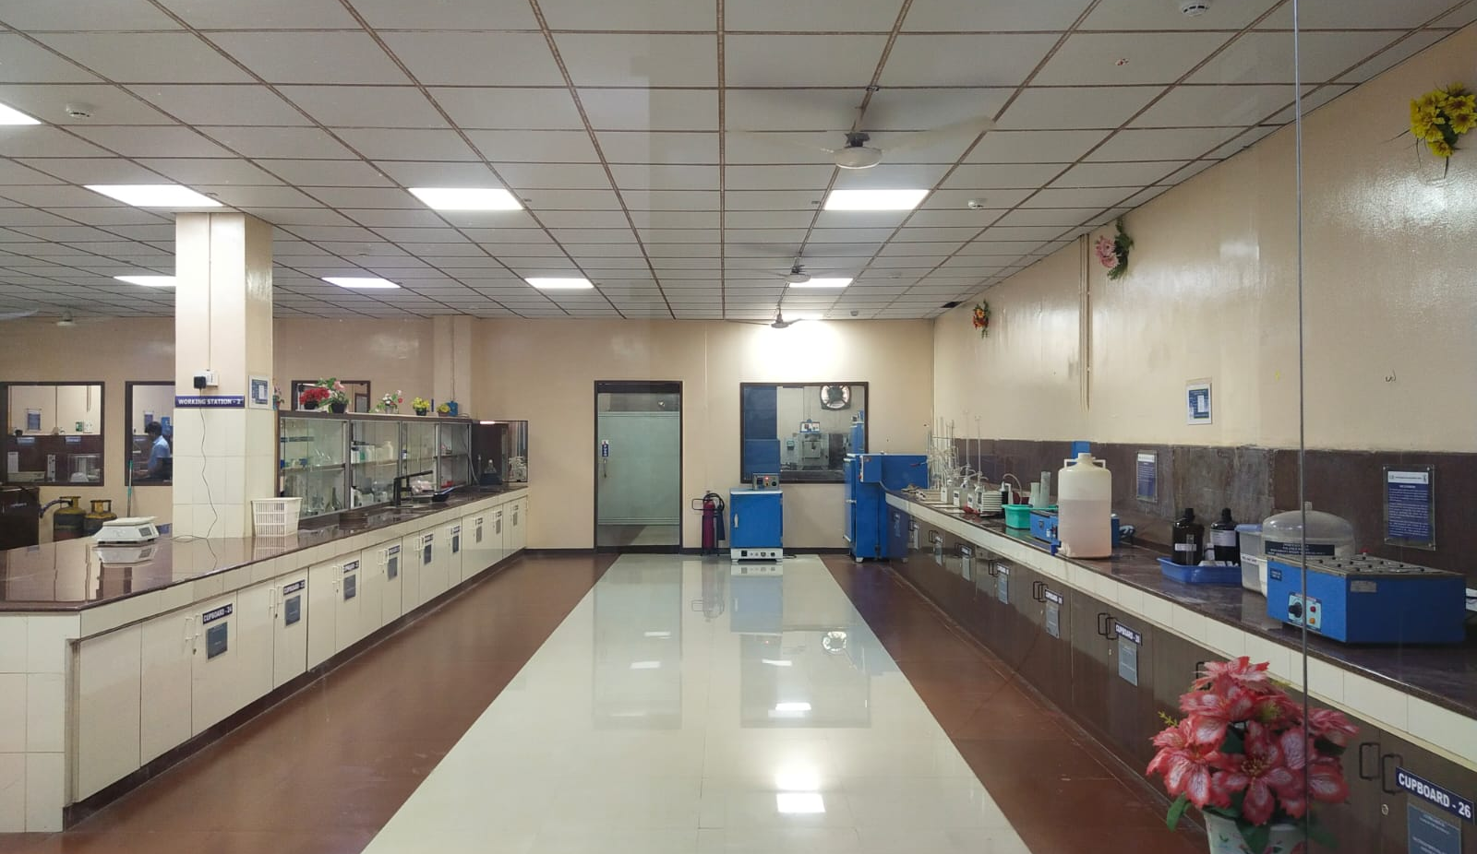

Slide 6
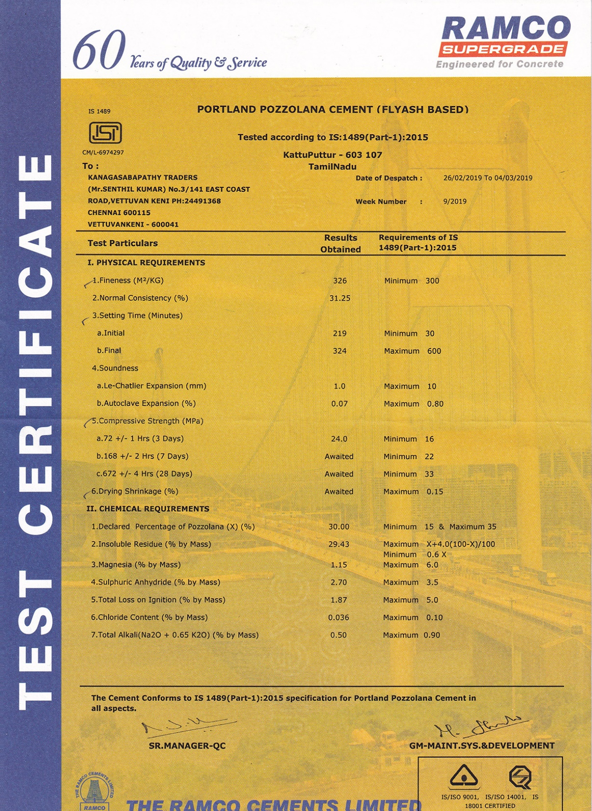

Slide 10
SUPERCRETE ADVANTAGES
CEMENT | CONCRETE
High rate of compressive strength | High load carrying capacity . Faster removal of formwork
Adequate fineness and addition of Pozzolanic material | Better Workability
Low heat of Hydration | Crack Resistant
Addition of Pozzolanic Material | High Ultimate Strength Low efflorescence Impermeable concrete
Controlled Particle size distribution | Better compatibility with admixtures for longer slump retention time
Balanced Chemical composition | Better resistance to sulphate and chloride attack
ENHANCED DURABILITY IN CONCRETE + HIGH COMPRESSIVE STRENGTH = TOTAL QUALITY CEMENT

Slide 12
How does Ramco Super Plaster benefit the users
S.No. | Parameters | Ramco Super Plaster ( Indicative value) | Benefit to the user
1 | Air Content ( %) | 7.8 | High Workability and cohesiveness Crack resistant
2 | Water Retentivity ( %) | 80
3 | Pull out strength 7 days ( N/mm2) | 0.8 | Better adhesion strength
 | Pull out strength 28 days ( N/mm2) | 1.2 | Better long term adhesion strength
4 | Flow as per Flow table test (mm) | 210 | Higher workability
5 | Bulk Density ( g/litre ) | 900 | Higher volume

Slide 14
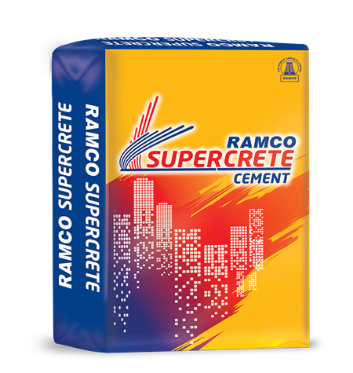
EMAIL
akp@ramcocements.co.in

